Slide 1
Housing Development and Financial Assistance Funding Application
FY 2024 Affordable Housing Fund (AHF), HOME & Community Housing Development Organization (CHDO) Funding Proposals
January 17, 2024

Slide 2
Logistics
In Teams Webinar-
Muted on entry
Please enter questions into the Q&A box and we will answer them during the Q&A portion-
Raise hand to ask a question
Notes:
Jose talk about Teams

Slide 3
Agenda & Objectives
Introductions
GCRA, Programs, and the “Eligibles”
Questions/Break
The Application
Training Objectives:
Overview of HOME & GCAHF requirements
Overview of the application and scoring criteria
Overview of Environmental Review
40 min.
10 min.
30 min.

Slide 4
Welcome and Introductions
Imma Nwobodu, Program Director
Francisco Arnaiz, Senior Community Development Planner
Jose Reynoso, Associate Community Development Planner
Kristin Conley, Associate Community Engagement Specialist
Notes:
Welcome from Imma
Introductions
Have attendees introduce themselves, Virtual then Room

Slide 5
About GCRA
Established in 1974
Administers Community Planning and Development (CPD) funding from HUD for Greenville County:
HOME, CDBG, ESG, and HOME-ARP
Greenville County Affordable Housing Fund (AHF) (local funding)
Used to address affordable housing, homelessness, economic development, and neighborhood revitalization serving specifically low to moderate income communities.
Notes:
Greenville County Affordable Housing Fund (AHF) – Local funding from the Greenville County Administration created to assist with the furtherance of making housing affordable in the County. HE GCAHF was established in 2019 as a result of the recommendation of the 2018 Affordable Housing Study for Greenville County to support production and supply of affordable and workforce housing in the County. The general purposes of HOME and GCAHF are expanding the supply of decent and affordable housing and workforce housing, particularly rental housing, for very low income-, low-, moderate-, and middle-income residents (GCAHF only), strengthening the abilities of state and local governments to design and implement strategies for achieving adequate supplies of decent housing affordable to the residents.

Slide 6
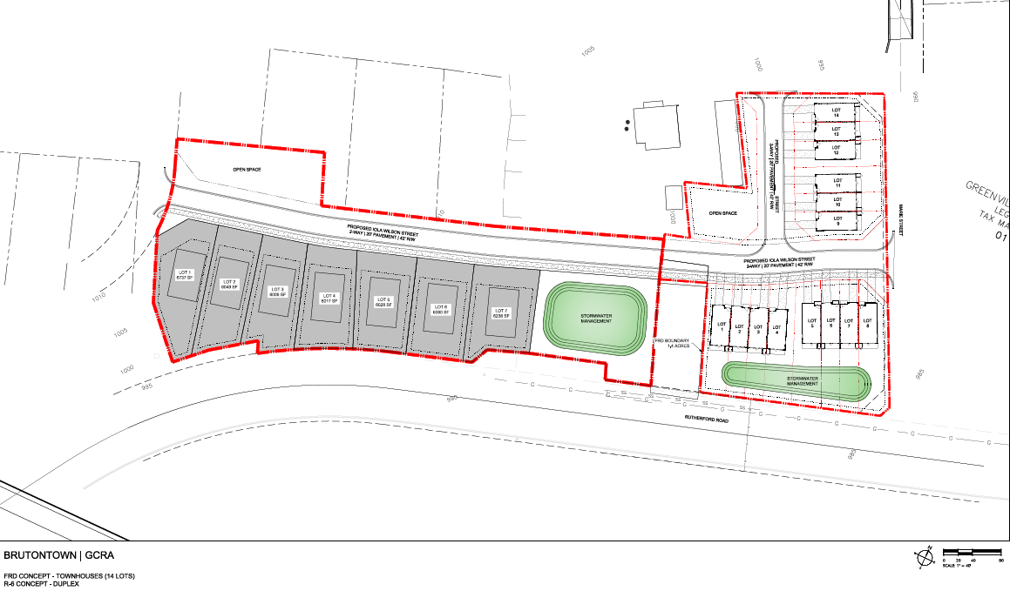
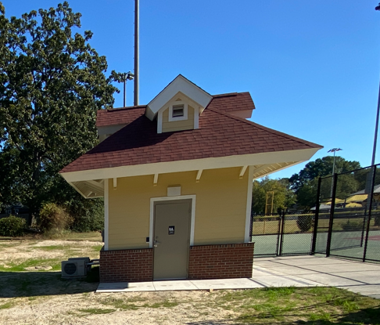
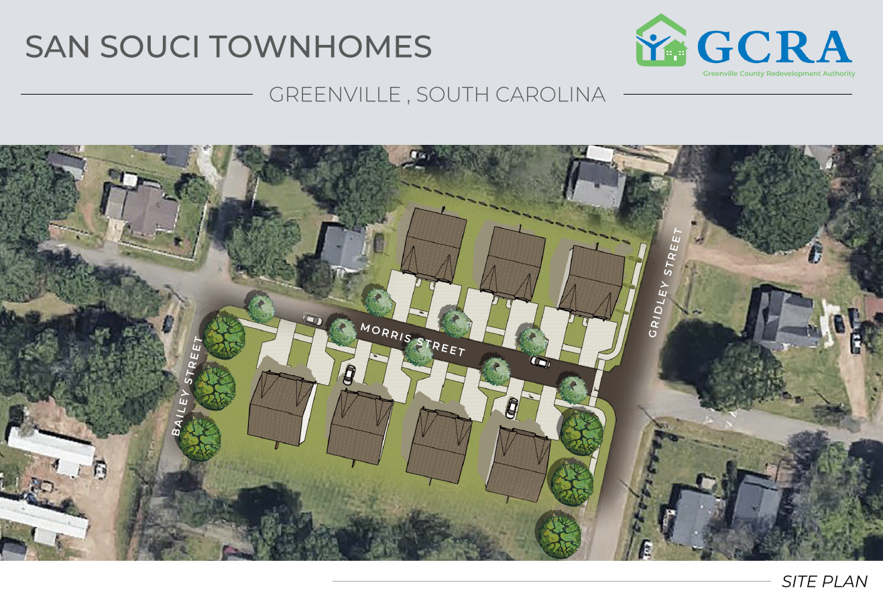
In House Projects
Notes:
Iola Wilson St. creation (and future housing) in Brutontown
ADA bathrooms at Emmanual Sullivan Park in Fountain Inn
Sidewalks at Miller Place housing development
San Souci Townhomes at Gridley and Morris 14 units 50-100 AMI
Fairview – Phase 11 14 units, Phase II 19 units 33 Townhomes for 50-100% AMI

Slide 7
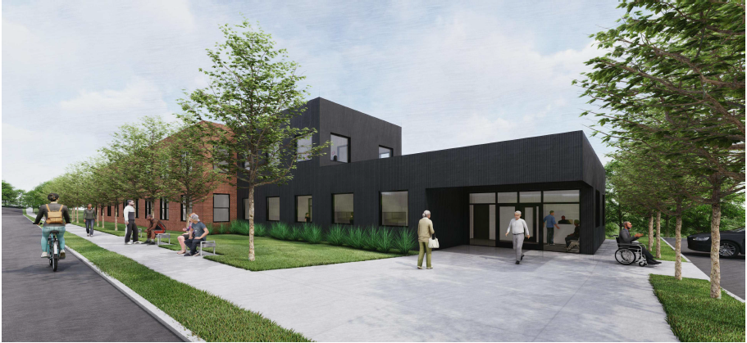
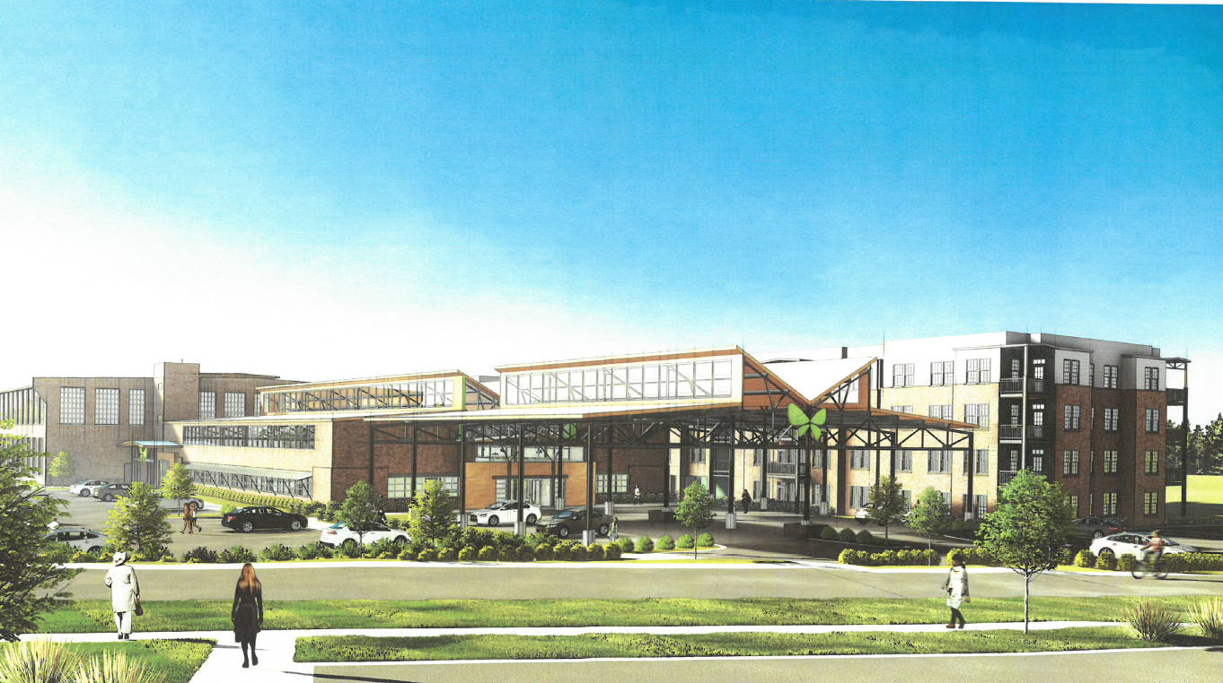
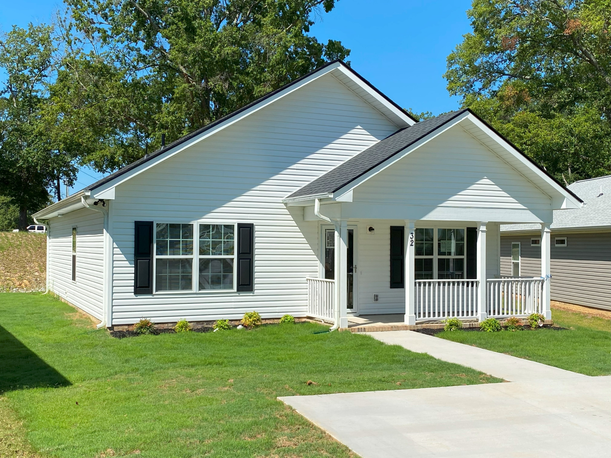
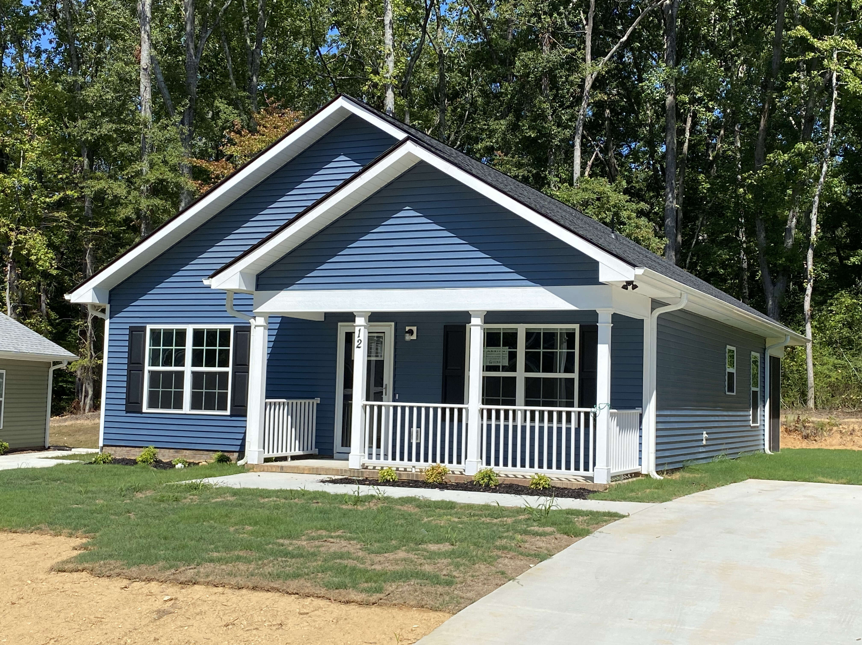
Partner Projects
Notes:
NHE 72 affordable rental units up to 60% AMI (and soon to be Butler II)
Church Street Place – 36 units PSH with UHC
Woodside Neighborhood in Simpsonville with H4H (under 60% AMI)
Gordon Street Mill Apt. – 116 units < 60% AMI with M. Peters Group

Slide 8
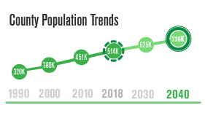
Purpose of HOME & AHF Programs
Increase the production, promote availability and accessibility of affordable rental and homeownership opportunities for very low, low, moderate, and middle-income residents.
Strengthen public-private partnerships in the production and operation of affordable housing by providing gap financing to projects serving very low-, low-, moderate- and middle-income residents.
Strengthen the local government's ability to design and implement strategies for achieving adequate supplies of affordable housing.
Ensuring that housing affordability is attainable Countywide.

Slide 9
HOME & AHF Eligible Applicants
Nonprofit organizations - Developers
For-profit organizations – Developers
Non-profit organizations
Community Housing Development Organizations (CHDOs)
HOME Only
Notes:
CHDO – Definition – from HUD – “a private nonprofit, community-based, service organization that has, or intends to obtain, staff with the capacity to develop affordable housing for the community it serves”
We will get into the funding details for each of these applicants.

Slide 10
Eligible Areas/ Project Locations
Greenville County
Including city boundaries of Greer and Fountain Inn
Excluding city limits of Greenville
Notes:
AHF – City of Greenville has their own Affordable Housing Fund as well as their own HOME funding, which is why they are not included in our eligible areas/locations.
AHF is only within the boundaries of Greenville County, while HOME has the two exceptions of the city limits of FI and Greer (Laurens and Spartanburg counties).
Funds used in the City limits of Fountain Inn, Greer, Mauldin, Simpsonville, Travelers Rest and the Unincorporated Area of Greenville County.

Slide 11
Special Emphasis Neighborhoods
Brutontown
New Washington Heights
Poe Mill
Sans Souci
Woodside Cotton Mill
Judson
Sterling
Brandon
Mills Mill
Duncan
Monaghan Mill
Freetown
Needmore and Sunnyside – City of Greer
Sanctified Hills – City of Fountain Inn
Woodside Mill - City of Fountain Inn
Woodside Mill – City of Simpsonville
Notes:
We have our areas that we can serve and then we have our priority areas
Majority of the special emphasis neighborhoods are in the textile Cresent outside city limits
Also open to infill and making neighborhoods have a diverse income range for households.

Slide 12
Eligible Uses
HOME: Units for rent or sale will have very low-, low-, or moderate-income households
AHF: Units for rent or sale will have very low-, low-, moderate- and middle-income households
Rehabilitation for affordable housing
Conversion of non-residential to residential
New construction of affordable housing
Assistance to first-time homebuyers
Notes:
Project line items – from acquisition, site improvement, pre-development cost (must be aware of the logistics and timing), demolition, financing fees, developers fee, construction etc.

Slide 13
Priorities
HOME Priorities
AHF Priorities
New rental and homeownership units in the County’s Special Emphasis Areas
Increase homeownership opportunities for families at or below 80% AMI
Rental units offered at or below 50% AMI for small/large families, seniors, and disabled persons
Rental units available for very low (30% AMI & below) and low (50% AMI and below) for small/large families, seniors, and persons living with disabilities.
Homeownership opportunities for families at 50% - 80% AMI
Affordable Homeownership and Rental Units for Middle income families 81% - 120% of AMI.

Slide 14
HUD Income Limits
GREENVILLE COUNTY - FY 2023
 | # of Persons in Family
 | 1 | 2 | 3 | 4 | 5 | 6 | 7 | 8
Extremely Low 30% Income Limits ($) | 18,700 | 21,400 | 24,050 | 26,700 | 28,850 | 31,000 | 33,150 | 35,250
Very Low 50% Income Limits ($) | 31,150 | 35,600 | 40,050 | 44,500 | 48,100 | 51,650 | 55,200 | 58,750
Low 80% Income Limits ($) | 49,850 | 57,000 | 64,100 | 71,200 | 76,900 | 82,600 | 88,300 | 94,000

Slide 15
HUD Income Limits
LAURENS COUNTY - FY 2023
 | # of Persons in Family
 | 1 | 2 | 3 | 4 | 5 | 6 | 7 | 8
Extremely Low 30% Income Limits ($) | 13,300 | 15,200 | 17,100 | 19,000 | 20,550 | 22,050 | 23,600 | 25,100
Very Low 50% Income Limits ($) | 22,200 | 25,400 | 28,550 | 31,700 | 34,250 | 36,800 | 39,350 | 41,850
Low 80% Income Limits ($) | 35,500 | 40,600 | 45,650 | 50,700 | 54,800 | 58,850 | 62,900 | 66,950

Slide 16
HUD Income Limits
SPARTANBURG COUNTY - FY 2023
 | # of Persons in Family
 | 1 | 2 | 3 | 4 | 5 | 6 | 7 | 8
Extremely Low 30% Income Limits ($) | 16,650 | 19,000 | 21,400 | 23,750 | 25,650 | 27,550 | 29,450 | 31,350
Very Low 50% Income Limits ($) | 27,700 | 31,650 | 35,600 | 39,550 | 42,750 | 45,900 | 49,050 | 52,250
Low 80% Income Limits ($) | 44,300 | 50,600 | 56,950 | 63,250 | 68,350 | 73,400 | 78,450 | 83,500

Slide 17
Projects targeting low-income families will receive additional points
Income Targeting
Greenville County Median Income : $89,000
Source- Income Limits | HUD USER
Target population​ | Income Target ​ | Income range ​
Extremely Low-Income ​ | <=30% of AMI | <= $26,700 (​4 person HH​)
Very Low-Income ​ | <=50%of AMI​ | <= $44,500 (4 person HH)​
Low-Income ​ | <=80% of AMI | <= $71,200 (4 person HH)​
Middle Income​ [AHF] ​ | Up to 120% of AMI | <= $106,800
Notes:
All of this is available from HUD online
https://www.huduser.gov/portal/datasets/il.html. If project is in City of Greer, Spartanburg County, use that HUD Metro FMR Area., If Fountain Inn/Laurens use Laurens

Slide 18
Eligible Beneficiaries – HOME funds
The eligibility of households for HOME assistance varies with the nature of the funded activity.
RENTAL: For rental housing and rental assistance, at least 80 percent of benefiting families must have incomes that are no more than 60 percent of the HUD-adjusted median family income for the area.
In rental projects with five or more assisted units, at least 20% of the units must be occupied by families with incomes that do not exceed 50% of the HUD-adjusted median. The incomes of households receiving HUD assistance must not exceed 80 percent of the area median.
HOMEOWNERSHIP: All HOME funds used for homeownership assistance must benefit homeowners whose family income does not exceed 80 percent of the area median income.
Notes:
Eligible Ben AHF – Greenville County 81-120 AMI

Slide 19
AHF & HOME Eligible Project Costs
Site acquisition
Pre-development cost
Hard costs for construction and rehabilitation activities
Site improvements
Infrastructure specific to development of site
All cost must be directly associated with specific housing development project.

Slide 20
Funding Availability
GCAHF 2024 Funding: TBD
Note: 80-90% of funding is available for development projects
Last 6 Years HOME Grant Allocations
HOME Program Set Aside & Allocations
HUD requires a 15 percent set aside for CHDOs
10% - set aside for Planning and Administration
The County earmarks approximately:
45 percent of remaining HOME funds for Housing Partners & GCRA projects.
30 percent of HOME funds for projects in the five participating municipalities
Additional funding may be available for projects subject to the availability of Program Income.
Fiscal Year | HOME Allocation
2023 | $1,255,180
2022 | $1,265,383
2021 | $1,145,414
2020 | $1,193,967
2019 | $1,114,857
2018 | $ 1,225,415
Notes:
HUD requires a 15 percent set aside for CHDOs (est. $190,000)
The County earmarks approximately 20 percent of remaining HOME funds for Housing (est. $140,000)

Slide 21
HOME & AHF Forms of Funding Assistance
Applicant Type | Available Financing Option​s
CHDO [HOME] | Grant funding subject to affordability requirements Certification documentation required with application.
Nonprofits & ​ Public Agencies​ | Rental Units: 1% interest loan amortized for a period of up to 20 years. (30years on specific request) 1-year payment deferment period during construction. ​ Homeownership: 1% Interest rate, repayment upon sale of the unit.
For Profit Organizations: | Rental Units: 2% interest loan amortized for a period of up to 30 years. 1-year payment deferment period during construction Homeownership: 2% Interest Rate
Gap Funding Request: ​ | 1 – 4 units: Maximum request: 20% of the total development cost or $40,000 per unit, which ever is the lesser.​ Multi – Family units: Maximum request: $12,500 per unit. Affordability period consistent with HOME regulations.​
Grant or Forgivable Loan:​ | 10 percent of total funding request. Not to exceed $100,000​
Notes:
Up to 30 years, but generally the amortization period is 20 years
However, the lower per unit subsidy the better the project feasibility.
1 – 2 unit project – 40% of total development project
Multi family units - per unit subsidy subject to change based on availability. Room for exception

Slide 22
HOME Affordability Period
Rental Housing Activity​ | Minimum Period of Affordability in Years​
Less than$15,000 per unit​ | 5 years​
$15K-$40K per unit​ | 10 years​
Greater than $40K per unit​ | 15 years​
New Construction​ | 20 years​
HOME & GCAHF AFFORDABILITY PERIOD
Homeownership Activity​ | Minimum Period of Affordability in Years​
Less than$15,000 per unit​​ | 5 years​
$15K-$40K per unit​ | 10 years​​
Greater than $40K per unit​ | 15 years​
*Minimum Investment: $1,000 per unit

Slide 23
Questions? 10 Minute Break!

Slide 24
The Application
Notes:
The application can be found at ourwebsite GCRA-sc.org. Then it is under our services and grants and loans. There is the main application and then the financial section as well.

Slide 25
Application Requirements
Eligibility & Completeness
Site Control
Developer Experience
Developer Capacity
Plan Consistency & Market Demand
Cost Reasonableness
Project Feasibility & Profit Reasonableness
Readiness to Proceed
Notes:
Eligibility and Completeness – are you located in an eligible area, are the project and activities we will be funding eligible activities?
Site Control – own house our have done work towards acquisition
Developer Experience – partnership, part of team that understands project
Application is for project that we are directly funding
Describe development team, the people you have, identify the capacity and experience
Plan Consistency – Referencing the Consolidated Plan. We will be using the current consolidated plan that runs through the end of our FY 2024 that is located on our website. Also, GCRA and the County completed an Affordable Housing Study, if applying for AHF then please reference that study.
Market Study – testing the market
Give outline, side description, consistency with neighborhoods, rents in the area
Can do market analysis
If have larger project can hire someone
Cost reasonableness – is it feasible cost? – further talked about in a few slides
Project feasibility and profit reasonableness- pro forma
Readiness to proceed – commitments

Slide 26
Application Scoring
Criteria​ | Maximum Points (100)​
Completeness, Program Eligibility and Site Control​ | 20 points​
Consistent with County Goals and Address Demonstrated Need | 25 points​
Financial Feasibility​ (Including Leveraging and Per Unit Subsidy) 1-4 units (No more than 20% of TDC) | 20 points​
Developer Experience, Capacity, and Project Readiness​ | 25 points​
AHF: Income Targeting Consistency with Priorities (30-50 percent AMI)​ HOME: Neighborhood Impact | 10 points​
Notes:
NO hard and fast rule for per unit subsidy/leveraging, but this is gap financing. One caveat to this is that your subsidy/leveraging can be adjusted based on your target AMIs. So if you are looking at providing housing for middle income households versus 50% AMI households, then we would expect you to be asking for less funds than say someone with housing for 50% AMI. SO it all goes hand in hand when assessing levering and per unit subsidy.

Slide 27
Market Study
Development Description construction type, #buildings, #units, gross rents, & population served
Site Location Description include area map and site photos.
Market Area Description include map showing nearest full-service grocery, pharmacy, school, and comparable developments
Market Area Economy workforce numbers and anticipated incomes as relevant to the development's targeted income group
Summary Comparable Developments Describe existing affordable housing developments by type, driving distance from the subject development, population served, #units by bedroom size, gross rent by unit size, service and on-site amenities, occupancy rate
Notes:
Completeness, Program Eligibility and Site Control
An identification of the geographic Market Area by census tracts, jurisdictions, street names, or other geography forming the boundaries from which potential renters will be drawn (include a map which clearly delineates the Market Area)

Slide 28
Market Study: Key Takeaways
Market strengths/weaknesses (compatibility with surrounding uses; the appropriateness of location; service facilities; on-site amenities; off-site amenities and their driving distance from the development etc.)
Positive and negative attributes and issues that will affect the property's performance and any proposed mitigation or modification to project.
Market justification for the proposed development, including the proposed rents by unit and population type.
Notes:
We are open to scope of this being large to small, this is at the minimum.
For homeownership, an appraisal will be needed

Slide 29
Leveraging and Per Unit Gap Fund Request
Need for Gap fund request for GCAHF/HOME.
Identification of other committed funds from other sources.
Analysis of the Per Unit of GCAHF/HOME in comparison to other funding sources identified.
NOTE: Projects using fewer GCAFH/HOME subsidy dollars per unit will receive more points than projects using more GCAHF/HOME subsidy dollars.
Notes:
This will be evaluated under financial feasibility

Slide 30
Developer Experience & Capacity
List and describe projects completed by the organization similar to the proposed project
List and describe experience of all development team members including consultants (if applicable)
Most recent financial statements should show enough liquidity to initiate and complete project.

Slide 31
Cost/Profit Reasonableness & Financial Feasibility
Cost comparable to similar projects in the same geographic area
Reasonable rents within affordability guidelines
Adequate funding and project’s ability to pay debt service over the affordability period.
Minimum DCR of 1.15 (Rental units)
Funding Leverage
Developer fee less than 15% of TDC
Notes:
Looking at other projects

Slide 32
Funding Commitments
Comparable procurements
Bidding
Commitment to what entity
Firmness of commitment and terms & conditions
Timing of disbursement
Strength of funding participants or other sources

Slide 33
Readiness to Proceed
Timelines must be realistic and achievable
Describe dates:
Funding commitments
Closing dates
Construction start-up and completion
Occupancy
All projects must start within 12 months of award notice.
Homebuyer units must be sold within 9 months of construction completion
Rental units must be occupied within 24 months completion.

Slide 34
Submission Requirements
Application Due Date – February 8, 2024
One (1) full electronic version with all required attachments, submitted via OneDrive.
Email Jose Reynoso at jreynoso@gcra-sc.org for the OneDrive Link before on or before February 7, 2024 by 5pm.

Slide 35
Housing Development FUNDs – HOME and GCAHF Selection process and Timeframe
Timeline
Jan, 2024
NOFA published
Today
Training – Thursday January 18, 2024
Feb 8, 2024
Electronic Submission link request deadline
February 2024
Application Review and Scoring
March 12 and 26, 2024
GCRA Admin Committee and Board approval
April 2024
Greenville County Council - Finance & Committee of the whole approval
May 2024
Awards
1 July 2024
Submission to HUD – May 15, 2024
Funding Available July 1, 2024
July–Dec 2024
Execute Development Agreement contingent upon receipt of applicant’s documents*
*Applicants Documents
Commitment of other funding sources
Updated development budget
Project completion schedule
Site control completed
Legal Description of proposed properties including BB#s

Slide 36
Environmental Completed Inhouse
Understanding the ER requirement and process is necessary for planning and executing your projects in a timely manner.
An environmental review must be completed before any projects are initiated in order to be eligible for funding reimbursements.
The nature and size of your project will determine the level of environmental review required.
Notes:
JOSE
National Environmental Policy Act (NEPA) of 1969
NEPA requires all federal agencies to consider and address any environmental impacts that result from activities and projects they fund or sponsor.
As an administrator of HUD program funds, GCRA is required to conduct an Environmental Review (ER), and to mitigate any negative impacts of funded projects.
ER’s are conducted in accordance with HUD's regulations at 24 CFR Part 58.

Slide 37
Related Laws and Authorities : Laws and Authorities
Historic Preservation **
Floodplain & Wetlands **
Noise
Hazardous & Toxic Sites
Endangered Species
Air
Important Farmlands
HUD Env. Standards
Environmental Justice
Notes:
JOSE

Slide 38
Environmental Reviews
Levels of Review​ | General Time Line​
Exempts​ | 1 week​
CE Not Subject to​ 24 CFR 58.5​ | 1 - 4 weeks​
CE Subject to ​ 24 CFR 58.6​ | 3 months or less​
EA​ | 3 - 5 months or more​
EIS​ | 5 months or more​
Notes:
JOSE

Slide 39
FTHB Program
Package should include:
HBA Income Form
(ALL household income must be included and number of people in the house)
Ratio Sheet
Initial Loan Estimate
Environmental Review Form
Property Inspection Form
Certificate of Completed Home Buyers Education
Appraisal if new construction
New construction $240,000 (revision in progress)
Existing Home $195,000 (revision in progress)
Manufactured Homes must be de-titled and have a deed issued and on a brick foundation (approval is at the discretion of the director for Manufactured Homes)
Notes:
New # for Limits not yet approved

Slide 40
Show Application
Grants & Loans - Greenville County Redevelopment Authority (gcra-sc.org)

Slide 41
Contacts
John Castle – Executive Director jcastle@gcra-sc.org EXT 114
Imma Nwobodu, Program Director inwobodu@gcra-sc.org EXT 115
Jose Reynoso – Associate Community Development Planner jreyneso@gcra-sc.org EXT 127
Francisco Arnaiz- Senior Community Development Planner farnaiz@gcra-sc.org EXT 120

Slide 42
Thank you!

